Slide 1


DFV-Chogori Project A memory centric distributed transactional platform
Discussion with Riselab, UC Berkeley
Seattle Cloud Lab/Cloud Storage Team
08/13/2020

Slide 2
Agenda
Chogori Project Phase I recap
Open sourced under MIT license at May, 2020
Platform for multiple modern cloud data services
Chogori Latest Development
Since last meeting (April 2020)
March towards first service – Distributed In-Memory OLTP SQL
Technology Challenges
Focus of today’s meeting
Would like to have opportunities to collaborate
Notes:
Hao

Slide 3
Chogori Project Phase I recap
Chogori is piloting project for next generation of cloud scale distributed data platform.
High efficient distributed transaction with strong consistency and high throughput.
Microsecond latency distributed operation with memory centric processing.
Flexible platform architecture for future multiple cloud scale services
Newly cloud DC technology is driving new efficient and cost effective system architecture.
Computing – Moore’s law, Amdahl's law -> coordination-free parallelism. SIMD, GPU, and DSA.
Networking – Faster, kernel bypass.
Storage - New memory/storage tier.
Chogori innovations (phase I)
Low latency platform – integrated network core bypass and data processing
K2-3SI – Sequential consistency with external causal relationship, and Serializable Snapshot Isolation level.
Notes:
Hao

Slide 4
Chogori Project Phase I recap - TPC-C Perf
12 warehouses, 4 client cores, 2x4 server cores, 40GbE RDMA
New Order and Payment transaction types
12,800 txns/sec and 375,800 read or write ops/sec
Notes:
Justin

Slide 5
Latest Development: SKV design
Need to push down basic operations to storage nodes: filter, projection, and partial update
Storage nodes must know schema of records
Dynamically-defined schemas tell us the record fields, types, and which fields to use for the partition and range keys.
Records are not self-describing. Fields are serialized in binary form, with a reference to the schema cached locally on the storage node.
Key fields are encoded into a composite string key. Need an order-persevering encoding for each type.
Notes:
Justin

Slide 6
Latest Development: SQL
Infrastructure
Networking/Transport
Process model (PostgreSQL)
Data model
relational -> SKV
Monolithic Database - > Partitioned Collection in Multi-tenant service
Functionality
DDL, DML
Bootstrap, reload
Notes:
Jian

Slide 7
Technical Challenges
Network layer re-design
SKV Push-down compute model, capable of supporting multiple L3 services(SQL, Graph, etc.)
Distributed SQL query design
Memory caching strategy
Share-nothing(CPU core) architecture vs multi-threaded shared memory
Notes:
Ivan

Slide 8
Network Layer Re-Design
RDMA connection setup time is 100s of usec
No control or visibility into how RDMA operates on the NIC. So we can’t use cutting edge congestion control algorithms for example
RDMA connection scalability is still a concern.
We only use RDMA send and receive anyway.
XDP+SmartNIC? DPDK?
More flexible but much more we need to implement: congestion control, flow control, memory management, etc.
Notes:
Justin

Slide 9
SKV Push Down: Vertically distributed query
The boundary between generic pushdown (native in SKV) and service specific pushdowns?
Want to support filtering, projection, joins, etc.
Want it to be flexible for other data models (e.g. a graph DB)
JIT or LLVM?
How to handle scheduling under usec level latency goals?
What API to expose to a push down function? For example, can it read or write to another node?
Notes:
Justin

Slide 10
Horizontal Distributed SQl Query
Horizontal distributed query means that queries should be automatically distributed across multiple nodes of clusters so that no single node becomes a bottleneck for query processing
Parallel scans
Parallel joins
Parallel aggregation
We process a query on a single node using PG at the current stage
Any suggestions to achieve the distributed query?
Split a complex query plan into smaller query segments for distributed execution?
Should we use llvm for distributed query execution?
Notes:
Jian

Slide 11
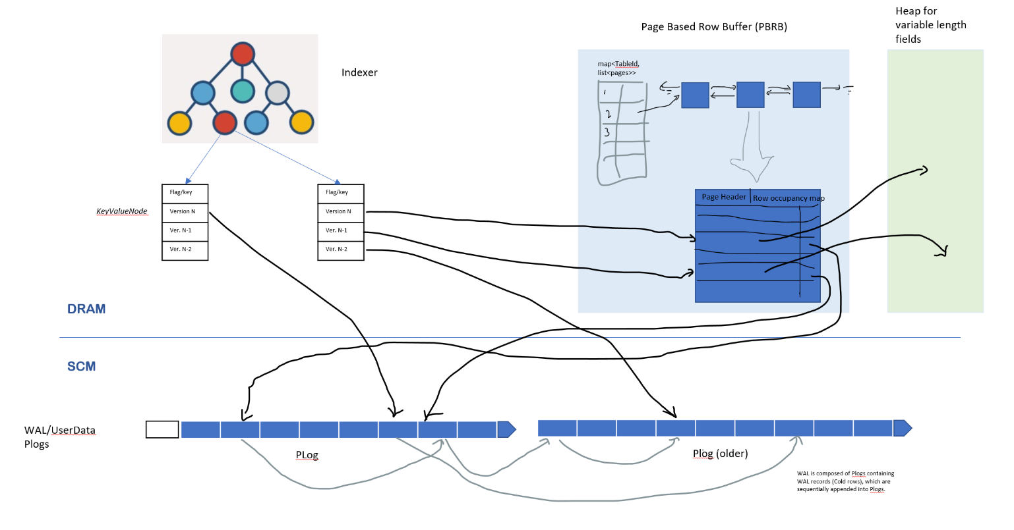
Caching strategy on Tiered memory
CPU cache + two tier of memory
DRAM – HOT indexer, Page Based Row Buffer(PBRB)
SCM – WAL Logs, “Log is Database”, no page data.
PBRB – Page Based Row Buffer
Full SKV record and Delta record in WAL
Caching fixed sized full row in Page
Fuzzy logic to make it like B+ tree data page to improve cache hit ratio
Memory Eviction – LRU rely on K2-3SI read cache
Reducing memory copy – newly written Delta record not in RBRB till read
Notes:
Hao

Slide 12
Technical Challenges (Recap)
Handling data in memory
Tiered memory architecture (DRAM+SCM)
How many tiers?(DRAM, SCM, HBM, ?)
Async vs sync access
Partial update support
Bigger than memory database (disk spill-over)
GC, compaction, recovery
Share-nothing(CPU core) architecture vs multi-threaded share-sometimes memory
Fast in-memory partition split for load shedding
Push-down compute model, capable of supporting multiple L3 services(SQL, Graph, etc.)
Dynamic library (.so)
Dynamic code runtime (llvm)
Static code
Scripting runtime (lua?)
Access to transaction, storage, routing layers.
Network layer re-design
Scalability (#connections)
Reliable message-oriented protocol
Performance challenges with establishing connection
Notes:
Ivan

Slide 13
Questions for you
What is your opinion on following:
What other areas Chogori can be useful?
We plan to go to GraphDB, right next thing to do? Any other suggestion instead?
Should we consider ML, and how?
How are we doing?
What direction should we go with our project to make it more valuable/impactful?
How to get there?
Notes:
Ivan

Slide 14
Q&A: Thank you
Offline questions?
Google group: https://groups.google.com/forum/#!forum/chogori-dev
Source code, design documents, performance results:
https://github.com/futurewei-cloud/chogori-platform
Hao “Jerry” Feng (jerry.feng@futurewei.com)
Justin Funston (justin.funston@futurewei.com)
Ivan Avramov (ivan.avramov@futurewei.com)

Slide 15
Chogori Platform – Goals
Microsecond-level request latencies
High throughput: >100,000 requests/second/core
Multi-core scalability
Utilize cutting edge network and storage technology
Kernel bypass and poll-mode I/O

Slide 16
Chogori Platform – Design Principles
Per-core shared nothing by default (from Seastar)
No locks, minimal cross-core synchronization
Each core operates on its own partition of the data
Asynchronous user-level task scheduling (from Seastar)
OS thread scheduling is expensive
Future, promise, and continuation pattern
Kernel-bypass networking (Chogori)
Context switch is expensive
Poll-mode for low latency
We use RDMA

Slide 17
Network & Transport
Per-core addressability (shared nothing)
Each core polls its own RX queue and sends on its own TX queue
No cross-core dispatch
Options: DPDK w/ SR-IOV, DPDK w/ flow director, RDMA queue pairs (QPs)
App 1
App 2
Socket Dispatch
CPU 1
CPU 2
CPU 3
CPU 4
CPU 5
CPU 6
CPU 1
CPU 2
CPU 3
CPU 4
CPU 5
CPU 6
NIC QP Dispatch
NIC RSS Hash
Incoming packets
Incoming packets

Slide 18
Network & Transport
Familiar socket-like interface
Send, receive
Listen, accept, connect
Flow control, congestion control, retransmission
TCP is complicated and user-space TCP libraries are not mature
UDP-based protocols are a possibility (eRPC, HOMA, etc.)
Our choice: Reliable connected (RC) RDMA
RDMA RC Send and Receive Operations
Layer above is message-oriented and network agnostic. Can use RDMA for performance or kernel TCP for compatibility.

Slide 19
Chogori RPC
Future-based RPC request and reply
Automatic serialization and deserialization
Minimized copies

Slide 20
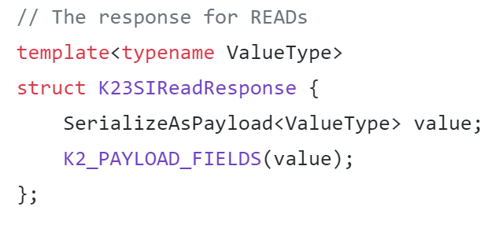
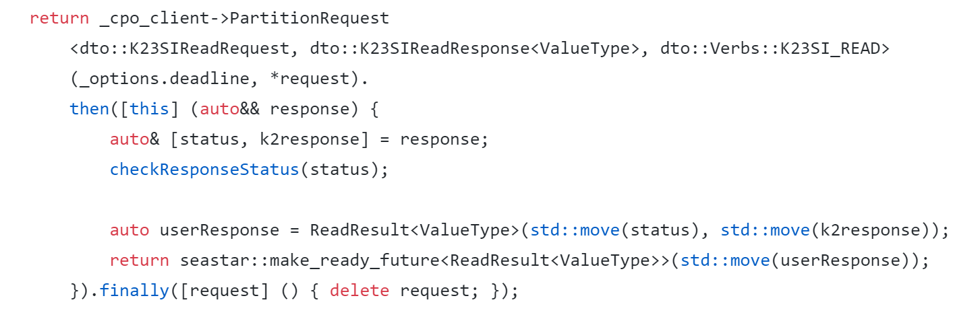
Chogori RPC

Slide 21
Chogori RPC – “Payload”
Segmented smart buffers for network transport
Minimizes copies
0-copy send and receive if payload native
1 copy (serialization/deserialization) otherwise
User data serialized
2nd block user data serialized
3rd block user data serialized
RPC header written
4
1
2
3
MTU
User Data

Slide 22
Distributed Transaction Tradeoffs
Consistency
PRAM → Causal → Sequential → Linearizable
Isolation
Read Committed → Snapshot Isolation → Serializable
Performance
Consequence of providing specific levels of consistency and isolation.
Typically dominated by the need for round-trip network communication, especially if it is a remote DC call.
Some require additional artificial wait (x…xxx ms) to achieve correctness
Name | Local DC roundtrip | Remote DC roundtrip
Percolator | ~0-10? | 8-14?
TiDB | 0 | 14
Spanner | 1 | 8
YugabyteDB | 4 | 10
CockroachDB | 4 | 6
Webinar: Comparing Distributed Transaction Architectures for the Cloud Era
https://www.youtube.com/watch?v=w_zYYF3-iSo
Notes:
Lets start by looking at DT tradeoffs.
They provide certain consistence and isolation, with costs to performance due to these features

Slide 23
Transaction Design Goals
Support for global transactions over datasets spanning availability zones
Scalable, multi-reader, multi-writer architecture
In-memory oriented data storage
Take advantage of low-latency network
Isolation: Serializability via Snapshot Isolation
Consistency: Sequential and External Causal Consistency
if two transactions have causal relationship even outside of our system, we guarantee that the causal relationship will be observed by all users of the system.
Our selected combination of isolation and consistency level, provides guarantee that applications will not observe any practical anomalies
K2-3SI: K2 Sequential consistency with Serializable Snapshot Isolation
An overview can be found here https://jepsen.io/consistency

Slide 24
Time And Sequencing
UniversalTime – a globally agreed-upon time-now
Not really possible in a distributed system – instead use TrueTime(start, end)
K2Timestamp
TrueTime + issuer id (TSO id)
The end value is guaranteed to be strictly increasing, providing strict sequence for timestamps from the same issuer
Timestamp Oracle (TSO)
To achieve optimal results, the clock error bound should be on the order of 1 network roundtrip (~10µs)
We support multiple TSOs but we do not require that they perform any consensus. Their clocks must be within known, bound error from UT.
Notes:
Time or really sequencing is central to distributed system coordination.
Ideal: UT. Not possible though – individual errors

Slide 25
Global Architecture
Geo Region
Geo Region
Time Stamp
Oracle
(TSO)
Time Stamp
Oracle
(TSO)
K2Nodes
K2Nodes
K2Nodes
K2Nodes
Clients
Persistence
Nodes
/w global
consensus
Clients
Persistence
Nodes
/w global
consensus
K2Nodes
K2Nodes
K2Nodes
K2Nodes
Control Plane Oracle
/w global consensus
(CPO)
Control Plane Oracle
/w global consensus
(CPO)
Time Stamp
Oracle
(TSO)
Time Stamp
Oracle
(TSO)
Notes:
This is a global architecture
Note that we have support for multiple TSO instances to achieve scalability. Clients can use timestamps from any TSO
CPO manages the service components and performs discovery, monitoring, load-balancing, etc. Instances use paxos
Persistence uses paxos

Slide 26



Maintaining immutable history with MVCC
Invariant: if a history is observed, it can no longer be modified. This extends to Global history we think of “observe” as a causal relationship
Reads on committed data always succeed
Writes are not allowed if history has been observed
In order to enforce, we use a ReadCache to remember the most-recent time at which a key has been observed
Reading/writing over a write intent requires conflict resolution
We designate a coordinator for each transactions (TRH) which is just lazily assigned to be the first write in the txn
Incoming (pending) write
Incoming Read
Attempt to modify observed history
Attempt to observe pending value
Attempt to modify pending value
1
2
3
4
5
6
7
8
9
10
11
12
13
14
time
Key history
= Read
= Committed Write
= Pending Write (Write Intent)
Notes:
Next, I would like to talk about another central idea – maintaining immutable history
To achieve this, reads allowed on committed, writes not allowed on observed, WI conflict resolution

Slide 27
Transaction overview
User Application
K2 Node
(participant)
K2 Node
(coordinator/TRH)
Persistence
K2 CPO
K2 TSO
K2ClientLib
Begin TXN
Reads
(K, txn_meta)
1st write in txn
Write
(K, V, txn_meta)
1st write designates the participant as coordinator (TRH)
Persist ()
Other writes
Write
(K, V, txn_meta)
Persist ()
Txn End (commit/abort, txn_meta)
Persist ()
Possible wait needed if
uncertainty window > txn duration
Notes:
… And the parts of a transaction: begin, reads, writes, end

Slide 28
Push operation for conflict resolution
TSO
CPO
Persistence
User Application
Clock
Write:
Key
Value
Txn meta
TRH key
Read:
Key
Txn meta
PUSH
K2 Node
MVCC
in-memory
data
store
Existing WI:
Value
Txn meta
TRH key
Status = PENDING
K2 Node (TRH)
Txn Handle
Transaction Record
Determine transaction
winner based on
Priority
Timestamp (pick newer)
Txn id ordering
etc
TSO Client
K2Client
Read Key Cache
Notes:
In cases o

Slide 29
Ending a transaction
User Application
TSO
Transaction Handle
Clock
K2Timestamp
TRH key
Txn id
Priority
Set<WriteKeys>
Local Start Time (to calculate total duration for extra wait)
CPO
Persistence
K2Node (TRH)
TSO Client
Transaction Record
- Txn state= Commited/Aborted
K2Node
(other participants)
K2Client
K2Node
(other participants)
Async
finalization
MVCC
Convert WI to committed value
23

Slide 30
Network cost, revisited
Name | Local DC roundtrip | Remote DC roundtrip
Percolator | ~0-10? | 8-14
TiDB | 0 | 14
Spanner | 1 | 8
YugabyteDB | 4 | 10
CockroachDB | 4 | 6
Chogori RO local (best case) | 1 | 0
Chogori R/W local | 5 (R, W, WP, C, CP) | 2 (WP, CP)
Chogori R/W remote | 2 (WP, CP) | 5 (R, W, WP, C, CP)
R: read
W: write
C: commit
CP: commit persist
WP: write persist
Most common case
Conflict detection is purely in-memory operation
Conflict outcome determination requires additional coordination/roundtrips
No additional wait needed if uncertainty window ~= network roundtrip
Sync write to disk is not necessary if we perform quorum writes to persistence.
Notes:
To revisit the network costs comparison, here is what we’ve achieved with Chogori

Slide 31
Q&A: Thank you
We are hiring!
Offline questions?
Google group: https://groups.google.com/forum/#!forum/chogori-dev
Source code, design documents, performance results:
https://github.com/futurewei-cloud/chogori-platform
Hao “Jerry” Feng (jerry.feng@futurewei.com)
Justin Funston (justin.funston@futurewei.com)
Ivan Avramov (ivan.avramov@futurewei.com)

Slide 32
Data Auto-Migration for Schema Changes
Schema changes are transactional, but data are not
Data might be distributed in multiple partitions
High cost to migrate data after schema changes from SQL client side, i.e., read all data and rewrite them
Need a mechanism to migrate data automatically

